Slide 1
8- Working with Numbers

Slide 2
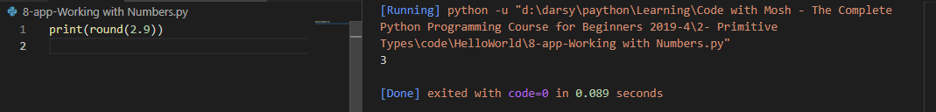
round(number)
for rounding a number.

Slide 3
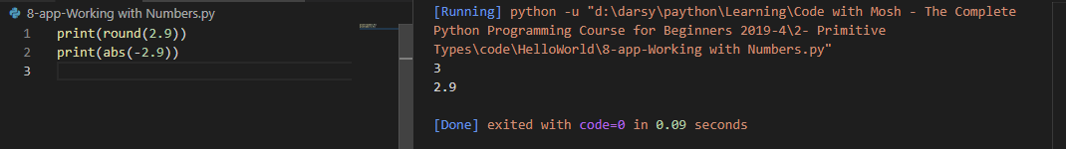
abs(number)
returns the absolute value of a number.

Slide 4
we have only a handful of built in functions to work with numbers.
If you want to write a program that involves complex mathematical calculations you need to use the math module.

Slide 5
module
A module is like a separate file with some python code.

Slide 6
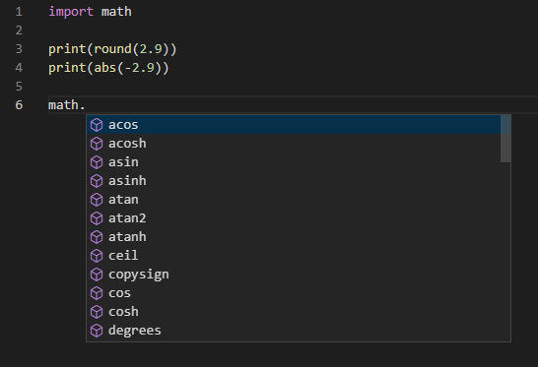
So, in Python we have this math module which includes lots of mathematical functions for working with numbers. But we need to import this module so we can use it on the top.
math in this program is an object
so we can use the dot notation to see all the functions or more accurately all the methods available in this object.

Slide 7
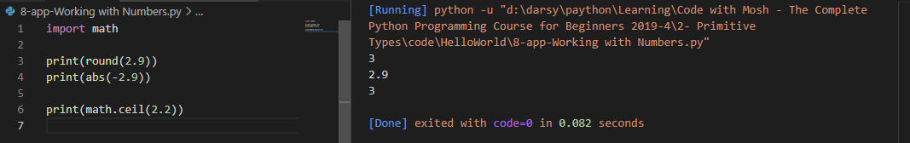
math.ceil(number)
for getting the ceiling of a number.

Slide 8
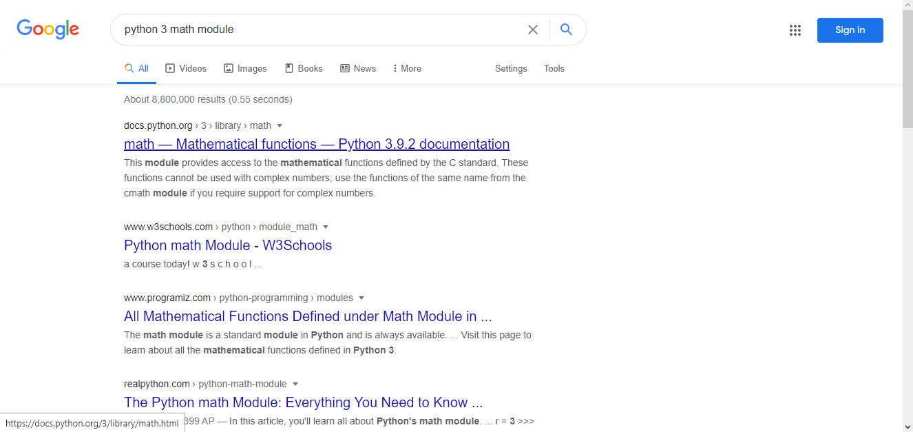
in this math module we have lots of functions. Let me show you how to find the complete list
Here on Google search for python 3. Make sure to add the version number math module

Slide 9
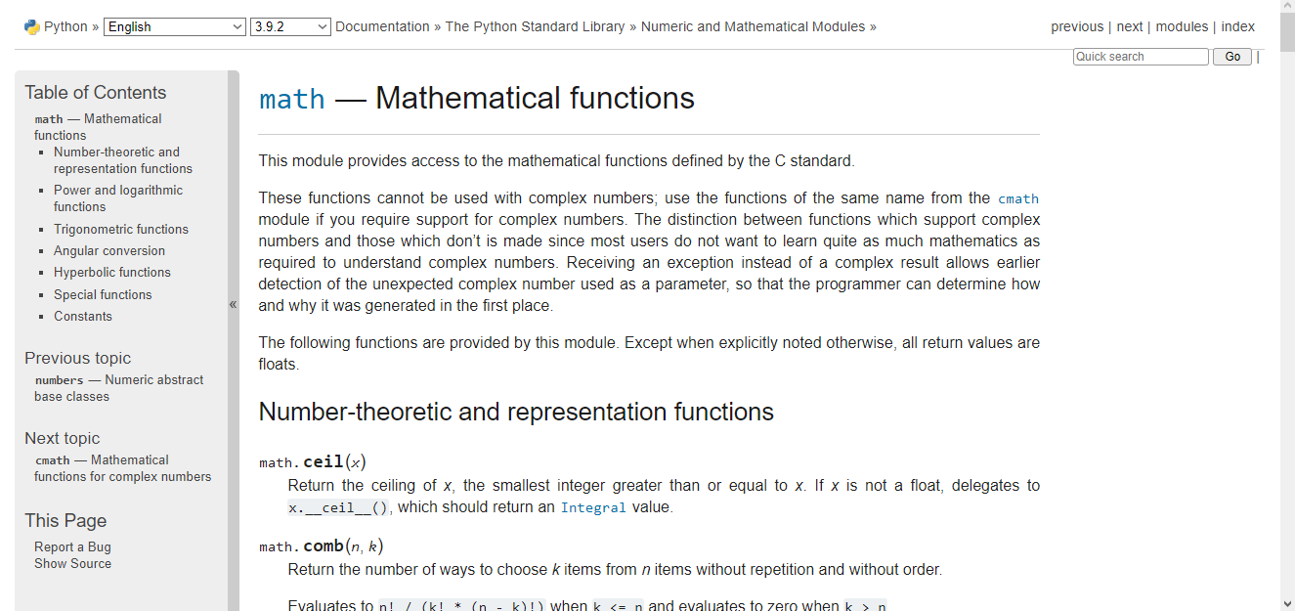
On this page you can see all the functions in the mass module

